Slide 3
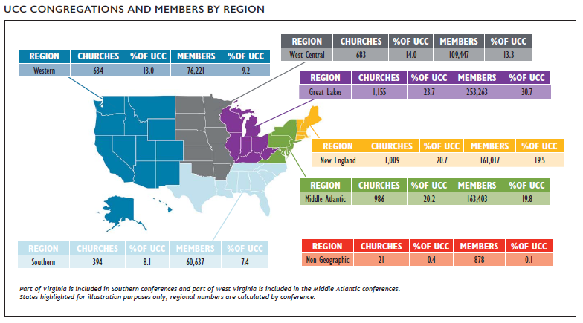
Congregations and Members
Notes:
At the end of 2018, there were 4,882 congregations in the United Church of Christ with a total of 824,866 members. Overall, the
membership of the UCC represented about half of one percent (0.55%) of total U.S. religious adherents* and was concentrated in the Great
Lakes, Middle Atlantic, and New England regions of the country.
*2010 U.S. Religion Census http://www.usreligioncensus.org/

Slide 4
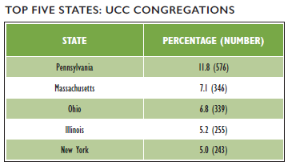
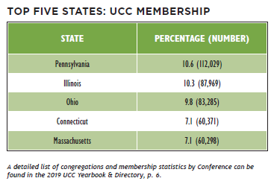
Congregations and Members
Notes:
In examining the distribution of congregations by state, 11.8% of all UCC congregations were located in Pennsylvania, which reported the greatest number of congregations. In total, the top five states with the most congregations contained over one-third (35.9%) of all UCC congregations.
Membership was concentrated largely in the Middle Atlantic, Great Lakes, and New England states. Just over two-fifths of UCC members (42.4%) reside in the top five states by membership. Notably, the states with the highest in number of churches are not necessarily the churches with the highest number of members. For example, Connecticut only has 4.6% of UCC churches (227), but has 6.8% of UCC members (56,488), while New York has 5.0% of UCC churches but only 3.6% (29,708) of UCC members. This indicates that churches in Connecticut, on average, have a higher membership than churches in New York.

Slide 5
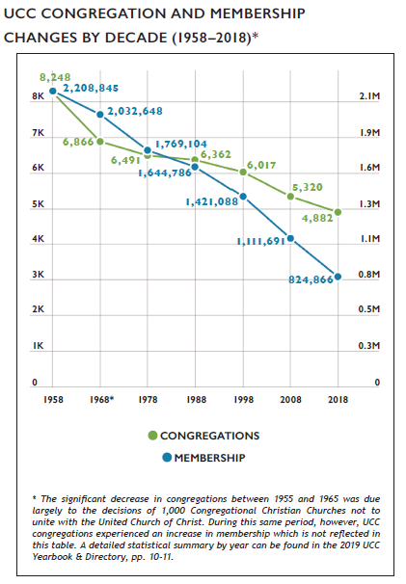
Growth and Decline
Notes:
Similar to other Protestant denominations, the UCC has experienced a decline in the numbers of congregations and members in recent decades. From 2008 to 2018 alone, the UCC encountered a net loss of 438 congregations and 286,825 members. Some of this decline, however, began prior to the formation of the denomination in 1957 as the number of congregations steadily decreased despite membership increases in the UCC’s early years.
In 2018, 85 congregations were removed from denominational records. Despite this decrease, congregational decline has slowed in recent years. From 2005 through 2007, the UCC experienced a loss of nearly three congregations per week on average (mostly as a result of General Synod’s resolution regarding same-sex marriage). In the past year, however, the loss rate has been about 1.6 congregations removed from denominational records per week on average.
Over the past year, 10 congregations have been added to denominational records (this includes churches that received standing, affiliated, or merged with another congregation). In total, 80 congregations received standing and were added to the UCC over the last five years, which is equivalent to a new congregation being added about every three weeks.

Slide 6
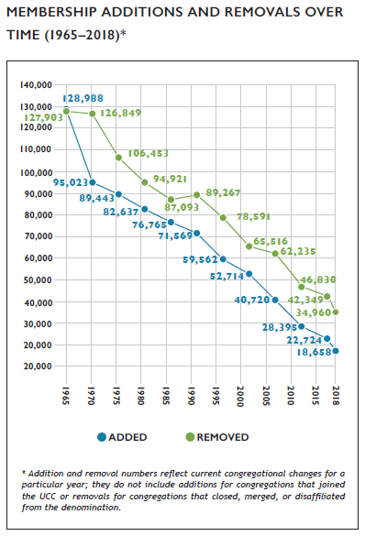
Membership Growth and Decline
Notes:
In general, the number of members removed each year exceeds the number of members added for that same time period. Members are removed from denominational records for a number of reasons including death, transfer of membership to another denomination, or updating of local church membership records.
The difference between UCC members added and removed was smaller in 2018 than in previous years. In 2017, there was a net removal of 16,660 members, but was slightly fewer in 2018, at 16,302 members. Looking further back, in 2015, there was a net loss of 19,625 members and in 2010, 18,435 members. (Note that net loss figures represented here are different than figures represented in the UCC Yearbook & Directory, which are based on total membership.) Over time, addition and removal differences have fluctuated; but both have decreased steadily as total membership has decreased.

Slide 7
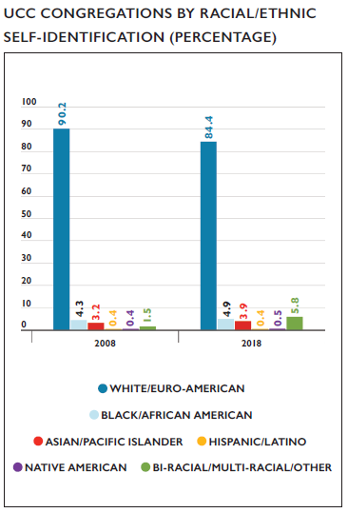
Congregations by Race/Ethnicity
Notes:
A substantial majority of congregations in the UCC self-identify as White/Euro-American (meaning that most members of a congregation belong to that particular racial/ethnic group). Over time, however, the UCC as a whole is becoming more racially/ethnically diverse. Over the last decade, the percentage of primarily White/ Euro-American congregations decreased from 90.2% in 2008 to 84.4% in 2018. During this same time frame, the percentage of Bi- Racial/Multi-Racial and Other congregations increased from 1.5% in 2008 to 5.8% in 2018.* In addition, the percentage of Asian/Pacific Islander congregations increased from 3.2% in 2008 to 3.9% in 2018. One cause of this shift over time may be due to the fact that the majority of congregations that close, merge, or disaffiliate with the denomination are primarily White/Euro-American congregations, thus decreasing the overall proportion of these congregations, while newer UCC congregations tend to be more racially/ethnically diverse.
*Note – Bi-Racial/Multi-Racial was introduced as a category in the Data Hub in 2010; 2008 figures reflect only congregations that identified as Other

Slide 8
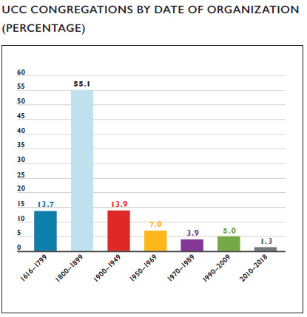
Congregations by Date of Organization
Notes:
While the UCC has only been in existence since 1957, many of its congregations were founded by predecessor denominations. Over two thirds of churches (68.8%) were organized before 1900. 17.2% of congregations were organized since 1950; of those, 1.3% of congregations have been organized since 2010.

Slide 9
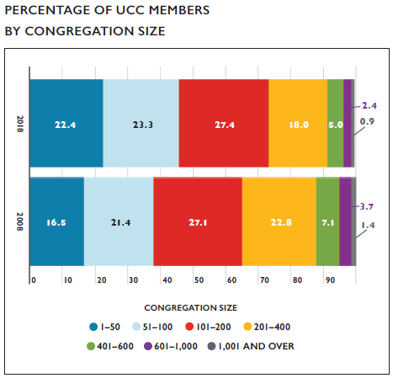
Congregation Size by Membership
Notes:
The majority (91.7%) of UCC members belong to congregations with fewer than 400 members with almost half (45.7%) attending congregations with 100 members or fewer. This reflects an overall trend within the UCC of membership being increasingly concentrated in smaller churches; in 2008, 87.8% of UCC members belonged to churches with fewer than 400 members and 37.9% belonging to churches with fewer than 100 members. The biggest changes in the past 10 years have been in churches with 1-50 members, which have increased from 16.5% to 22.4% of members since 2008, and churches with 201-400 members, which have decreased from 22.8% to 18.0% of members since 2008.

Slide 10
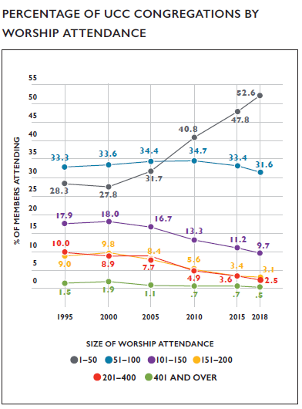
Worship Attendance
Notes:
When considering worship attendance figures rather than membership size, even more congregations are categorized as smaller churches. In 2018, eight in ten churches in the UCC (84.2%) had a weekly worship attendance of 1–100, an 8.7% increase from 2010 and a 22.8% increase from 2000. Over time, the percentage of congregations with greater worship attendance numbers has decreased steadily, with the most dramatic decreases occurring in congregations of 101–400 worship attenders since 1995. As a result, over half (52.6%) of all UCC congregations now have a weekly worship attendance of 1-50 individuals.

Slide 11
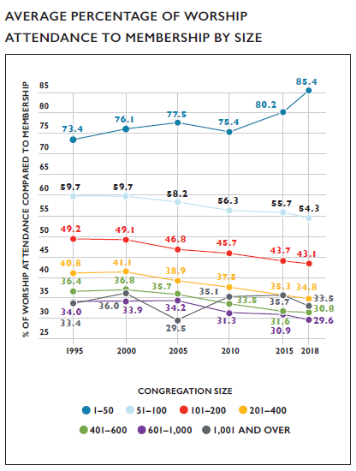
Worship Attendance and Membership
Notes:
The relationship between worship attendance and membership continues to shift incrementally over time. From 1995 to 2018, fewer people generally attended worship as an overall proportion of the numbers of church member, with two exceptions—the largest churches, which have effectively remained stable, and the smallest churches, which have seen an increase. In churches with 1,001+ members, 33.4% of the number of people attended worship compared to the total membership in 1995; while this figure has risen and fallen in the subsequent decades, the current figure is 33.5%. On average, there were 73.4% of people attending worship compared to the overall membership of a 1-50 member church in 1995; this percentage rose to 85.4% in 2018. In 2017, an average of 87.4% of members attended weekly worship for the same size congregation. The overall patterns suggest that a greater share of members may attend worship in smaller congregations than larger congregations, though this cannot be known for certain, as those who attend worship may not all be members.

Slide 12
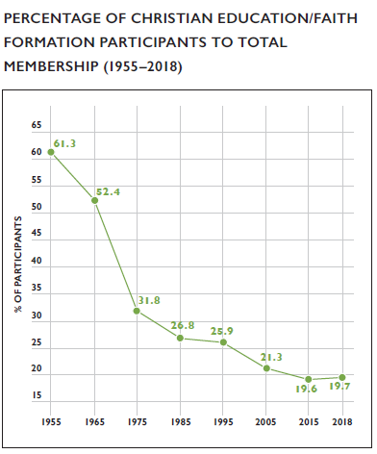
Christian Education/Faith Formation
Notes:
Since the 1950s, enrollment and attendance numbers for Christian Education/Faith Formation programming (also known as Church School or Sunday School enrollment in previous years) has been declining along with membership numbers. While this decline is not surprising, it is interesting to note that overall participation/ enrollment rates, when computed as a percentage of total membership, have decreased significantly from the 1950s and 1960s but has been a fairly stable percentage for the last decade. Currently, percentages indicate that roughly two out of every ten people in the UCC (19.7%) participated in these types of programs, at least in the traditional sense.

Slide 13
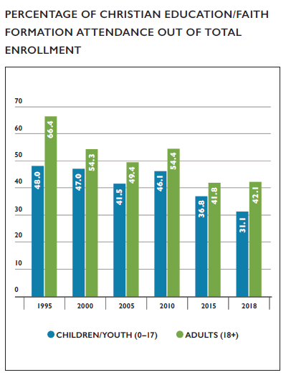
Christian Education/Faith Formation
Notes:
When comparing participation/enrollment with average weekly attendance figures, even fewer children and adults participated in Christian Education/Faith Formation programs on a regular basis. The gap between enrollment and attendance has increased incrementally over time, meaning that smaller percentages of total participants in Christian Education/Faith Formation programs are attending these programs on a weekly basis. These patterns matched average weekly worship attendance patterns, which have also decreased over time.
In general, adult Faith Formation programs were attended more regularly than children/youth programs. This may be due to a number of factors including competing interests for young people’s attention on Sunday mornings, the overall decline in numbers of younger people in congregational life, and increases in the diversity of family situations around divorce and co-parenting.

Slide 14
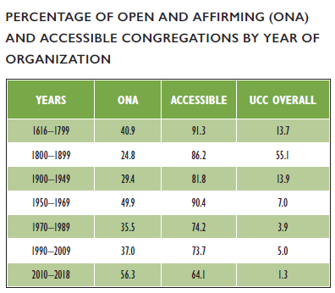
Congregational Designations
Notes:
In the past decade, there was a 94.0% increase in the number of Open and Affirming (ONA) congregations in the United Church of Christ, from 780 churches (14.7% of all UCC churches in 2007) to 1,513 churches (31.0% of all UCC congregations in 2018). ONA designations were most common in congregations organized in disparate periods – between 1616-1799 (40.9%), 1950-1969 (49.9%), and between 2010-2018 (56.3%). This suggests that ONA designation is likely more strongly correlated with factors other than congregational age; however, given that over half of the congregations organized since 2010 are ONA, this does suggest that the ONA designation is particularly important to new and currently forming congregations.
Accessibility was more closely linked to congregational organization year. Over eight in ten (85.2%) congregations overall self-identified as being accessible to individuals with disabilities. While the specific types and degrees of accessibility among these congregations were not known, it is interesting to note that congregations organized before 1970 identified as being accessible at an 80% or higher rate by organization age cohort while each age cohort of congregations organized 1970 or later had an increasingly smaller proportion of congregations that self-identified as being accessible.

Slide 15
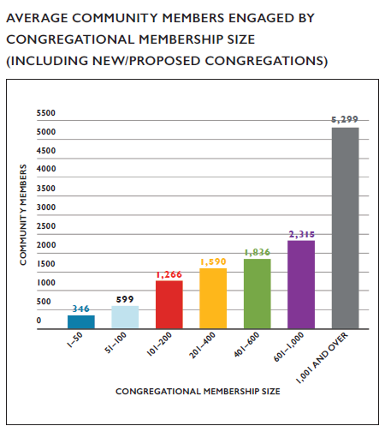
Congregational Outreach
Notes:
Congregational reports indicated that an average of 1,126 community members were impacted by each local church’s outreach activities and initiatives in 2018. The total sum of community members engaged in 2018 was 2,116,799 with 38.3% of congregations reporting (including new/proposed congregations). This is an increase in reporting from 2017, when 34.9% of all congregations reported this figure, likely due to the increasing familiarity with and reporting of this category from local churches.

Slide 16
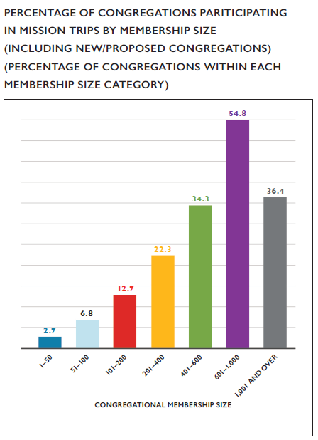
Mission/Immersion/Service Trips
Notes:
Since 2014, congregations have been asked to report whether members of their congregation participated in a U.S. or international mission/immersion/service trip. In 2018, 631 (13.0%) congregations (including new/proposed congregations) reported that members had participated in these types of trips. This was an increase from 2014 when 416 (8.1%) congregations reported trip participation. Notably, over half (54.8%) of congregations with 601-1,000 members reported participating in mission/immersion/service trips in 2018.

Slide 17
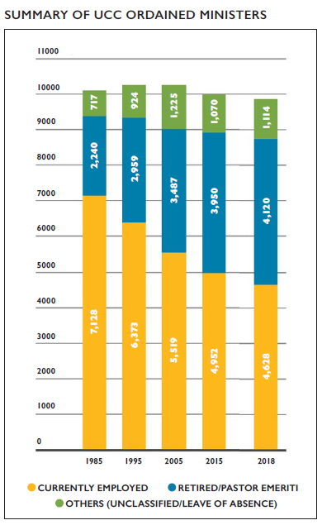
Summary of UCC Ordained Ministers
Notes:
At the end of 2018, there were 9,862 reported Ordained Ministers in Full Standing, including Retired Ministers and Pastor Emeriti. Of those 9,862 Ordained Ministers, nearly one-half (46.9% or 4,628) were employed, with 69.7% (3,228) of those employed actively serving in a local church (either a UCC church or non-UCC church). Four out of ten (41.8% or 4,120) were Retired Ministers or Pastor Emeriti, and 11.3% (1,114) were unclassified (ministers who did not hold a position at the time of Yearbook production or whose position had not been reported at that time) or were on a leave of absence. Currently, there are nearly as many Retired Ministers and Ministers Emeriti (4,120) as there are Currently Employed Ministers (4,628).
See Appendix for a detailed summary of Ordained Ministers by classification.
Over the last 33 years (1985 to 2018), Ordained Ministers only had a numerical net decrease of 223 (2.2%). The number of employed Ordained Ministers, however, decreased by over one third (-35.1%), while Retired Ministers and Pastor Emeriti saw an increase of 83.9% over this same 33-year period.

Slide 18
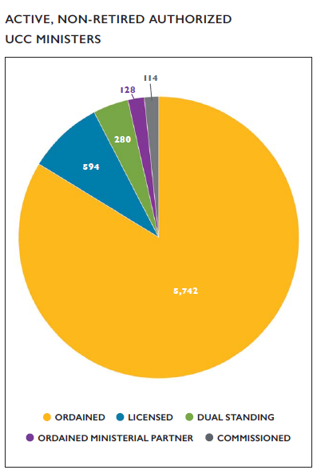
Authorized Ministers
Notes:
As of December 31, 2018, there were a total of 6,858 active (non-retired) Authorized Ministers in the United Church of Christ (Ordained, Licensed, Dual Standing, Ordained Ministerial Partner, and Standing Commissioned). Ordained Ministers were the largest percentage of active ministers reported (83.7%); and Licensed Ministers comprised the second largest group of Authorized Ministers (8.7%). In addition, three ministers hold standing in the Congregational Christian Church.

Slide 19
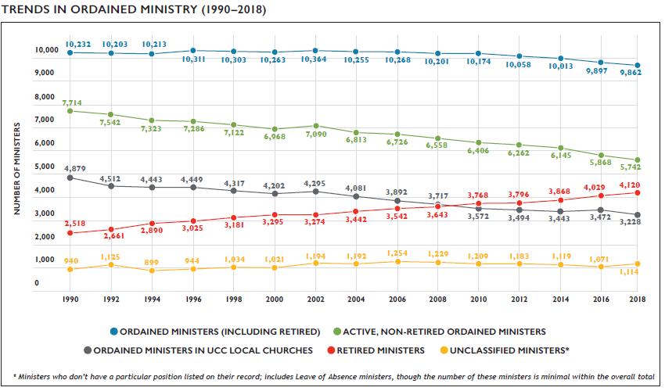
Trends in Ordained Ministry
Notes:
Since 1990, the number of Ordained Ministers has remained relatively stable, though there are slight incremental decreases in more recent years. At the same time, the number of Retired Ministers and Pastor Emeriti has increased steadily. Notably, since 1990 the decline in ordained ministers (-3.6%) has been much smaller than the declines in congregations (-22.9%) or membership (-48.6%) during the same time frame.

Slide 20
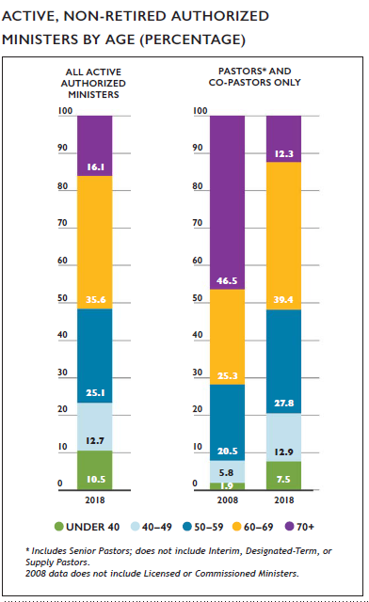
Authorized Ministers by Age
Notes:
Data regarding Authorized Ministers in the denomination reflects a population of predominantly older clergy. When all active (non-retired) Authorized Ministers were considered, over one half were age 60 and above (51.7%) and over three-quarters (76.8%) were 50 and older. In comparing trends among pastors and co-pastors, younger clergy are increasingly represented among local church pastors and co-pastors, with 7.7% under 50 in 2008 increasing to about 1 in 5 (20.4%) by 2018. Given that nearly 4 in 5 (79.5%) of local church pastors or co-pastors are 50 and older, which is slightly higher than the overall proportion of Authorized Ministers in the same age group, this suggests that older clergy are slightly more likely to be pastors or co-pastors than to be in other clergy roles.

Slide 21
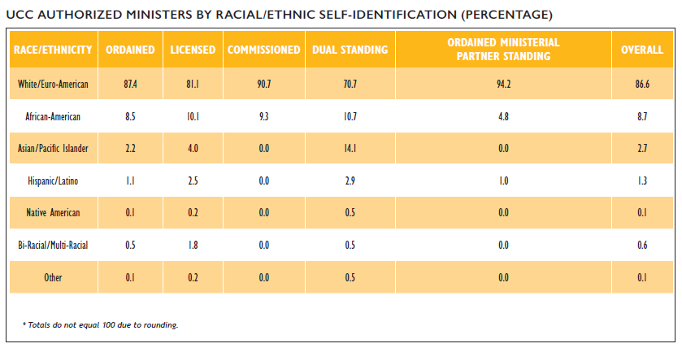
Authorized Ministers by Race/Ethnicity
Notes:
The majority (86.6%) of all active, non-retired UCC Authorized Ministers identified as White/Euro-American, with 13.5% identifying as non-white. Among the various types of authorization, Ministers with Dual Standing were the most racially/ethnically diverse group with three in ten (29.2%) ministers identifying as non-white. Commissioned Ministers and Ministers with Ordained Ministerial Partner Standing were the least racially/ethnically diverse authorization groups, with no Asian/Pacific Islander, Native American, or Bi-Racial/Multi-Racial ministers listed within denominational records.

Slide 22
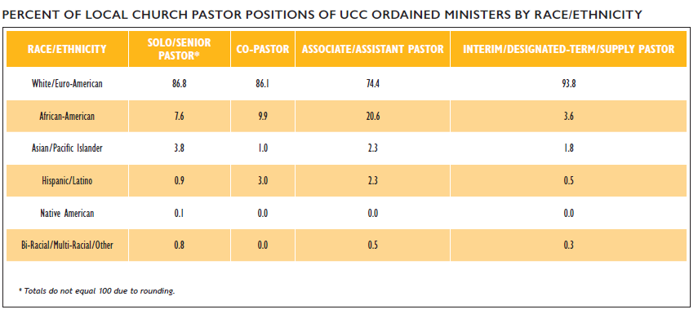
Ordained Ministers in Local Churches by Race/Ethnicity
Notes:
Regarding racial/ethnic representation in local church pastor positions, different patterns emerge based on position. Among senior/solo pastors, clergy who identify as African-American and Hispanic/Latino were proportionally under-represented (7.6% compared to 8.7% overall and 0.9% compared to 1.3% overall, respectively) while clergy who identify as Asian/Pacific Islander were represented at a higher rate among senior/solo clergy (3.8%) than among clergy overall (2.7%). Associate/Assistant clergy were notably more racially/ethnically diverse compared to clergy overall, with 25.7% of clergy self-identifying as non-white compared to 13.5% of all active, non-retired Authorized Ministers.

Slide 23
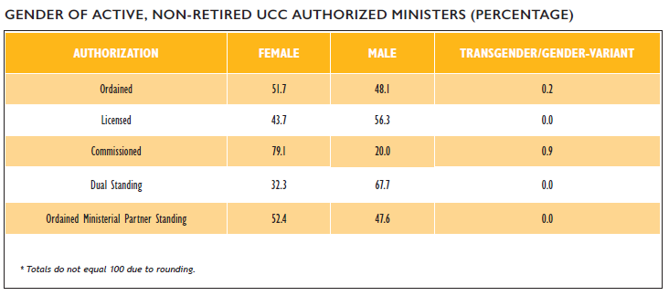
Authorized Ministers by Gender
Notes:
In total, approximately 51.7% of active, non-retired ordained ministers in the United Church of Christ identified as female, 48.1% identified as male, and 0.2% identified as transgender/gender-variant. This is a notable shift from the early 2000s, when according to the 2003 UCC Statistical Handbook only 27% of all Ordained Ministers identified as female. Among other categories of Authorized Ministers, Licensed and Dual Standing ministers proportionately identified more often as male, while nearly 4 out of every 5 Commissioned Ministers identified as female. Commissioned Ministers also had the highest proportion of transgender/gender-variant identifying clergy (0.9%) among categories of Authorized Ministers.

Slide 24
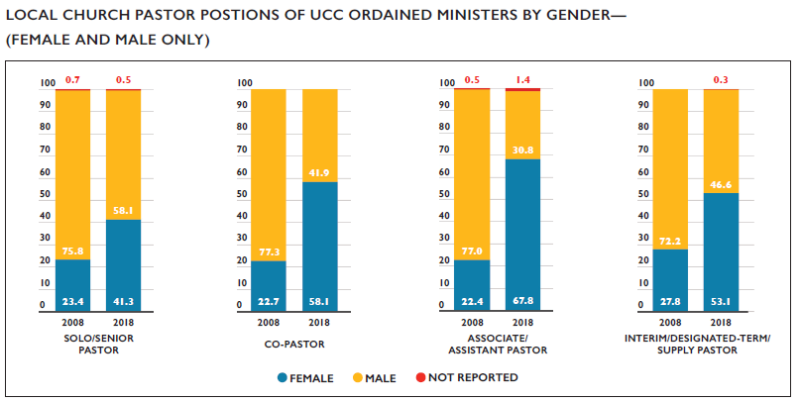
Ordained Ministers in Local Churches by Gender
Notes:
The percentage of active, non-retired female Ordained Ministers serving in local church pastoral positions has nearly doubled over the past decade, from 23.4% in 2008 to 41.3% in 2018. Four in ten (41.3%) senior/solo pastors identified as female in 2018, compared with 23.4% in 2008. Over half (58.1%) of co-pastors, half (53.1%) of interim/designated-term/supply pastors, and over two-thirds (67.8%) of Associate/ Assistant pastors identified as female.

Slide 25
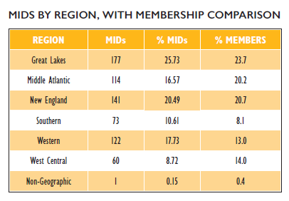
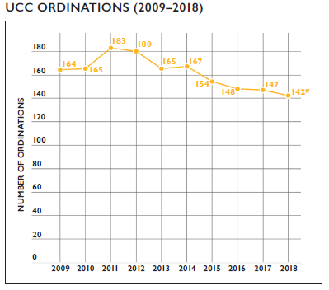
Ordinations and Members in Discernment
Notes:
The number of ordinations per year decreased over the past decade from 191 in 2008 to 142 in 2018. Throughout this time period, the 2012-2016 annual average of ordinations was 158 compared to the 2007–2011 annual average of 183 ordinations. When reviewing trends over the past several decades, however, ordination numbers fluctuated in similar ways; whether the declines in recent years signal a trend has yet to be seen.
As of April 2019, there were 688 active Members in Discernment on record within the denominational database. Members in Discernment (or MIDs) were concentrated within larger Conferences, as is to be expected, with the Massachusetts, Illinois, Connecticut, and Ohio Conferences reporting 28.5% of the total number of MIDs. Some regions, however, had proportionally more MIDs compared to their overall membership proportion in the UCC—in particular, the Great Lakes, Southern, and Western regions.
In terms of gender, females comprised 64.3% of all MIDs (a greater percentage than that of current female Authorized Ministers, which currently comprise 51.7% of all Authorized, non-retired clergy). Members in Discernment were also more racially/ethnically diverse than current Authorized Ministers with 48.3% identifying as non-white (compared with 13.5% of all Authorized Ministers identifying as non-white). This is a major increase from last year, when fewer than 25% of MIDs identified as non-white. This trend may be due in part to more accurate records on MIDs, as more than 100 people reported their self-identified race since 2017.
* Number of ordinations for 2018 and recent previous years is expected to increase in 2019 as additional records are updated by Conferences.

Slide 26
Local Church Financial Trends
Notes:
Operating expenses for an average local congregation in 2018 was $180,871, a $4,325 (+2.4 %) average increase from 2017. Average total income for a local church in 2018 was $228,368, a $21,551 (-8.6%) average decrease from 2017. Both the average operating expenses and income for local congregations increased from average amounts reported over the past decade—from $158,736 in expenses (a 13.9% increase) and $202,336 in income (a 12.9% increase) in 2008.
In 2008, Our Church’s Wider Mission (OCWM) giving represented 4.7% of total local church expenditures. This percentage decreased to 3.3% of total local church expenditures in 2018.
Overall, expenditures for congregations of the United Church of Christ increased from $950,538,969 to $967,554,113 in a period of four years (January 1, 2014 to December 31, 2018)—a 1.8% increase. This figure fluctuates annually, with some years experiencing increases in overall expenditures. For instance, the current 4-year increase is notably lower than in the 4-year period measured in the previous Statistical Profile between 2013 and 2017, which saw a 4.3% increase.

Slide 27
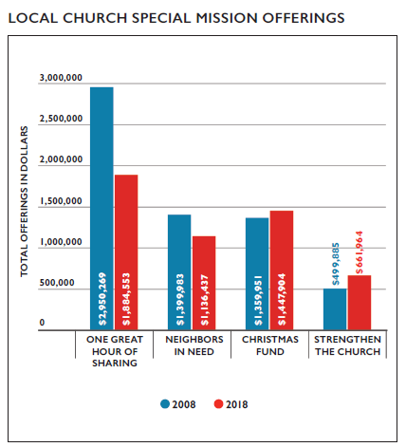
Stewardship and Mission Support
Notes:
Totals for wider church stewardship and giving by local congregations of the United Church of Christ decreased over the past several years. Over the past decade, the number of churches that have not given to any Special Mission Offering has increased. In terms dollars given, some Special Mission Offerings have seen increases, while others have seen decreases. The Christmas Fund and Strengthen the Church offerings have both increased since 2008 (6.5% and 32.4%, respectively). Meanwhile, contributions to One Great Hour of Sharing and Neighbors in Need have both declined since 2008 (-36.1% and -18.8%, respectively).

Slide 28
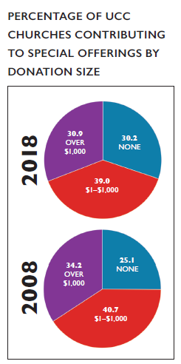
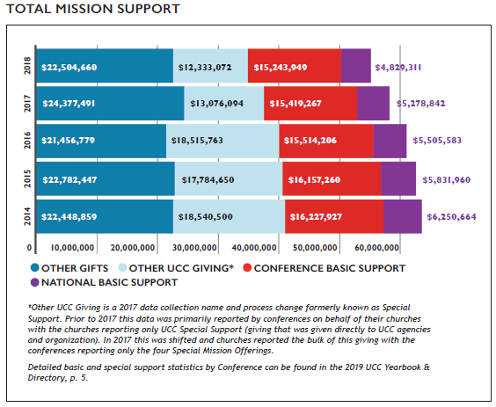
Stewardship and Mission Support
Notes:
Total mission support for 2018 decreased from the previous year by $3,240,702 (-5.6%) and has decreased 13.5% since 2014. Changes, however, have not been uniform across giving categories. While the data indicates that Other UCC Giving has decreased dramatically in the past 4 years (-33.5%), it is important to note that in 2017 the manner in which this data was collected changed.* National Basic Support has declined by 22.7% and Conference Basic Support has declined by 6.1% since 2014. Other Gifts—money given beyond the UCC—has virtually stayed at the same level since 2014, showing a net 0.25% increase.

Slide 29
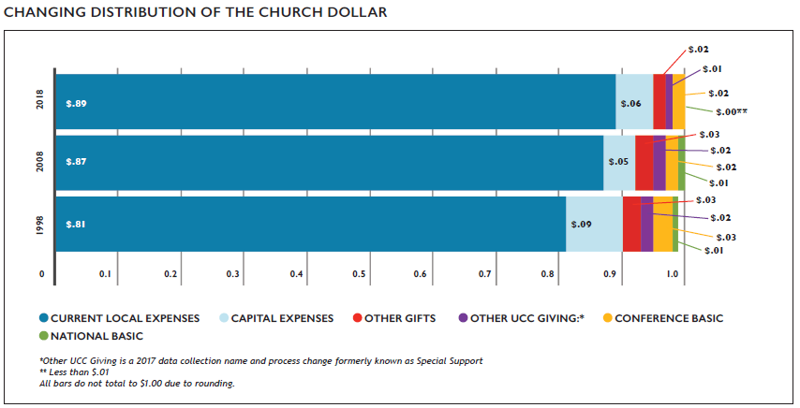
The Church Dollar
Notes:
In the last two decades, the distribution of the church dollar has experienced some noticeable shifts. Current local expenses have increased by $.08 while all others have decreased or remained steady. All types of UCC Giving (Conference Basic, National Basic and Other UCC Giving) have decreased in the past 20 years.

Slide 30
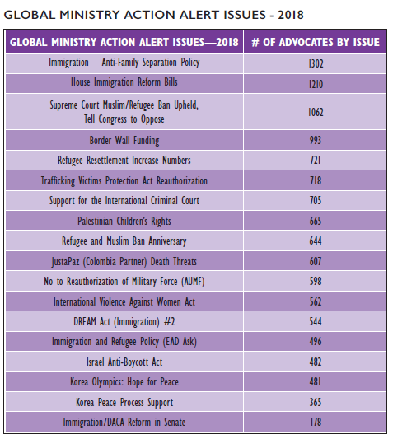
Special Report: Global Ministries Partner Priorities: 2018 Action Alert Issues
Notes:
Action alerts are created every week and sent through the UCC’s Justice and Peace Action Network. In 2018, there were 20 alerts relating to global issues, informed by our Global Ministries (UCC and Disciples) partners. Advocates who took action through our system sent emails and/or tweets to their representatives using language written by UCC staff.
The issue which had the highest number of advocates was immigration, including alerts against building a border wall, separating families in immigration detention, and President Trump’s travel ban. These numbers show that while most of our global action alerts have a fairly consistent number of advocates who contact their legislators, immigration was a particular area of concern. With a large part of the 2018 news coverage focusing on immigration issues and the 2017 General Synod resolution on Becoming an Immigrant Welcoming Church, this is not surprising. We are consistently seeing UCC advocates and churches interested in pushing back on restrictive immigration policies and wanting to be welcoming to our immigrant and refugee neighbors.
TO LEARN MORE AND JOIN THE JUSTICE AND PEACE ACTION NETWORK, SIGN UP HERE: HTTP://WWW.UCC.ORG/JOIN_THE_NETWORK

Slide 31
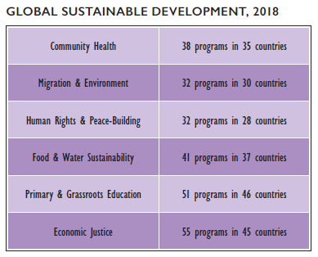
Special Report: UCC Humanitarian and Development Ministries (Made Possible by the One Great Hour of Sharing Offering, Endowment and Special Funds)
Notes:
The United Church of Christ is active in global sustainable development, refugee/asylum, and disaster ministries. This humanitarian and development work is rooted in theologies of “A Just World for All” and aligned with the United Nations’ Sustainable Development Goals. Volunteer ministries within the United States highlight leadership development, capacity building, and engagement.
The UCC occupies a distinct space in these humanitarian and development areas by linking faith communities, global faith based organizations, and civil society actors. These long-term and trusted relationships enable the UCC to leverage and multiply values, resources, and networks to accompany people who are the most vulnerable and impacted. A personal and flexible approach that extends from a theology of mutual love enables funds and technical expertise to be used to fill gaps, increase local capacities and create innovative strategies that are replicable by others.
Although numbers cannot capture the impact of this accompaniment that changes lives, the scope of UCC reach can be indicated by the number of locations and programs in which the UCC participated.
In 2018, the United Church of Christ was active around the world in global sustainable development in the areas of community health, migration & environment, human rights & peace-building, food & water sustainability, primary & grassroots education, economic justice.

Slide 32
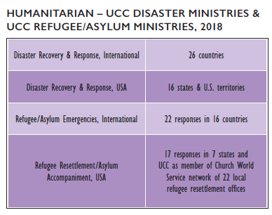
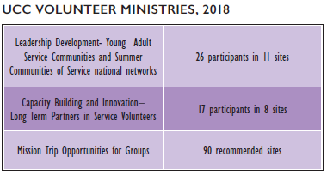
Special Report: UCC Humanitarian and Development Ministries (Made Possible by the One Great Hour of Sharing Offering, Endowment and Special Funds)
Notes:
UCC Disaster Ministries and UCC Refugee/Asylum Ministries are active in humanitarian areas of long-term recovery, immediate response and preparedness building both within the United States and internationally.
Leadership Development programs for young adults incorporate an action-reflection-action model that helps young adults build skills for a lifetime of leading at the intersections of congregations-community change—and faith. Long-term volunteer placements provide opportunities for adults of all ages to build capacity of local organizations around the United States in disaster, social services, refugee/asylum settings. And Mission Trip Opportunities enable groups to serve and to be immersed in hands-on justice settings throughout the USA.

Slide 33
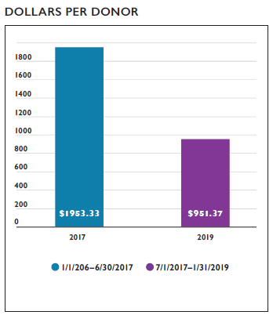
Special Report: The Caribbean Initiative: By the Numbers
Notes:
The Global Ministries Caribbean Initiative invited the entire church to witness together with the Caribbean region for a period of 18 months (July 1, 2017–January 31, 2019). Members of both the United Church of Christ and the Christian Church (Disciples of Christ) celebrated having relationships through several ways. This report provides the findings from this experience together:
Thirty-five different written, audio, video materials, songs and recorded webinars were published on the website, including, Bible studies, background documents for witness and advocacy, thematic presentations by partners, liturgical materials for special occasions and worship. Those materials are available through our website and you may access them here: https://www.globalministries.org/caribbeaninitiative
We hosted 9 interactive discussions through online webinars with an overall total of 336 participants. These webinars were recorded and kept on the website for further use and discussion. Here we include the themes of each webinar and the number of live attendees:
Caribbean Initiative Overview 17 people
Peace in the Eye of the storm 128 people
The quest for justice 21 people
Building a Sustainable Future 40 people
Migration and Human Trafficking 34 people
Just Economic Systems 24 people
Costly Peace for Colombia 24 people
Walking on Bare Feet 23 people
From the Shore to the Dry Land 25 people
During the initiative there were 5 People to People Pilgrimages and specific visits through the following countries:
Colombia: High-Level Delegation Pilgrimage: May 16th–22nd, 2017
Venezuela: Testimonio: Faith, Economy and Ecology Pilgrimage: General Justice and Witness Ministries: August 6th–12th, 2017
Cuba: Asere: Regional and Conference Ministers´ Pilgrimage: October 26th–Nov. 1st, 2017.
Dominican Republic: Global Ministries´ Board of Directors Delegation Pilgrimage: April 4th-10th, 2018.
Cuba: Woman-to-Woman Worldwide Disciples Women Pilgrimage to Cuba-October: 19th-Nov.1st, 2018.
On those travels participated the two General Ministers and Presidents of both Disciples of Christ and UCC (Colombia), 4 Conference Ministers (Colombia and Cuba), 4 Regional Ministers (Colombia and Cuba), a delegation of 10 Common Board of Global Ministries Members. Also, a group of 15 lay leaders from the Disciples Women participated in a Pilgrimage to Cuba.
Five Advocacy Backgrounders with analysis and specific recommendations for churches, regarding the Dominico-Haitian situation, Just Economic Systems-Venezuela and Peace in Colombia, are published on the Global Ministries’ web page, available for further study.
For the Caribbean Initiative alone, Global Ministries received almost $242,600 in donations from 255 donors between July 1, 2017– January 31, 2019, compared to the 18-months prior to the initiative (January 1, 2016–June 30, 2017), we received almost $205,100 from 105 donors.

Slide 34
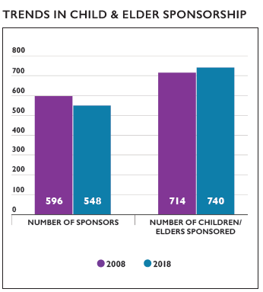
Special Report: Global Ministries Child and Elder Sponsorship Program
Notes:
The Global Ministries Child and Elder Sponsorship Program works with partner organizations that have long established connections with the United Church of Christ and the Christian Church (Disciples of Christ). In collaboration with partners, gifts to the Child Sponsorship program provide food, basic health care, and clothing and in some cases housing, school fees, uniforms, books and tutoring. The children range from 2–18 years old.
In many countries an aged individual is not entitled to government assistance such as social security or retirement benefits and in some countries an individual has worked for their government. The elders are individuals without enough income to sustain themselves or family support to care for them after age 60. Global Ministries Elder Sponsorship centers assist elders who have no place to live and no family to care for them. The sponsorship of an elder helps to provide shelter, medicine, and meals, ultimately allowing them an opportunity to live out their lives in dignity and solace in an environment where they feel loved and cared for.
Since the 2008 recession, the number of donors/sponsors has declined overall, while the number of children and elders sponsored varies daily. As we continue to recover from the decline in individual sponsorships, we found that most new sponsorships are from Christian Church (Disciples of Christ) congregations.
As of May 16, 2019, our records show 532 sponsors for 728 children/elders. This figure fluctuates daily with new sponsorships being added and cancelled sponsorships partnerships. The Family Village Farm in Kasam, India and Dumaguete Kalauman Centre for Development in Dumaguete City, Philippines consistently maintain the number of sponsorship and monetary gifts. The sponsorship program has 16 participating partner sites with 3 existing programs within the partner organization. With all transactions 100% of gifts go towards supporting children and elders in need. No dollars collected for the children and elders are used to support the sponsorship program operational cost.
GO ONLINE TO HTTPS://WWW.GLOBALMINISTRIES.ORG/CHILD_SPONSORSHIP TO LEARN MORE AND SIGN UP TO SPONSOR A CHILD OR ELDER.

Slide 35
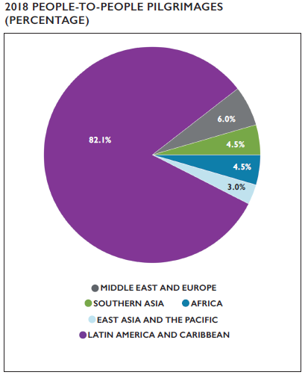
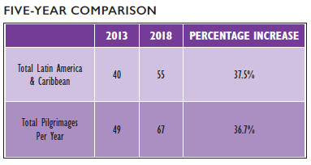
Special Report: People-to-People Pilgrimage Program
Notes:
The People-to-People Pilgrimage Program organizes international mission pilgrimages for congregations, regions, conferences, and other related organizations of the Christian Church (Disciples of Christ) and the United Church of Christ. In 2018, the Program organized a total of 67 pilgrimages. Latin America and the Caribbean remains the most visited area with 82.1% of the pilgrimages in 2018 due to its affordability and proximity to the United States.
The Program has seen a 36.7% increase in pilgrimages between 2013 and 2018. A 10.0% increase in travel to the Caribbean between 2017 and 2018 could be attributed to the Caribbean Initiative, although its impact will be further reflected in the next couple of years. In addition, 10.4% of 2018 scheduled pilgrimages were cancelled or rescheduled due to natural disasters, political tensions, and/or civil unrest.

Slide 36
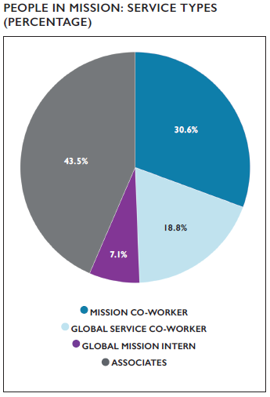
Special Report: Global Ministries: People in Mission
Notes:
The story began with the Haystack Prayer Meeting in 1806, the Women’s Boards of Missions in 1868 and with the first mission co-workers to India and Ceylon on the United Church of Christ side. A similar story started with the first the American Christian Missionary Society in 1849, the Christian Woman’s Board of Missions organized in 1874, and the Foreign Christian Missionary Society in 1875, with the first mission co-workers serving in Palestine on the Christian Church (Disciples of Christ) side. Together both churches have roughly two hundred years of service around the world.
With the creation of the United Church Board for World Ministries (UCBWM) in 1961, which would later become Wider Church Ministries in 2000, and the Division of Overseas Ministries in 1973, and then the Common Global Ministries Board in full mutuality in 1996, the United Church of Christ and the Christian Church (Disciples of Christ) have continued to move towards unity in our service to God’s global church.
With the mission to receive and share the Good News of Jesus Christ by joining with global and local partners to work for justice, reconciliation and peace, Global Ministries works with 290 partners in 80 countries and in the context of those partnerships, appoints mission co-workers to serve in various capacities around the world.
Since 2004, responding in faith to the challenge of a rapidly changing world, Global Ministries has emphasized Critical Presence in all phases of its mission and especially in its determination of where to designate precious resources. Critical Presence is understood as “to be timely and appropriately meeting God’s people and creation at the point of deepest need: spiritually, physically, emotionally and/or economically.” In this approach to global mission, priority is given to ministries of acompañamiento (accompaniment) with brothers and sisters in Christ as they face critical situations, which may include:
pastoral ministries related to fear and hopelessness where people are desperate for meaning;
dangerous or life-threatening situations related to social, economic, or political realities;
partners living in countries wherein the Christian faith is a minority faith;
interfaith relations;
conflict transformation and resolution; and
areas where Global Ministries can offer a distinctive presence.
In 2018, as a response to the challenging legacy of the term “missionary”, the board of Global Ministries voted to change the language used for international staff who are sent to serve to “Mission Co-worker”. This terminology better reflect the core values of Global Ministries: community, presence, mutuality, justice and peace.
In the graph we mention four types of mission co-workers:
A Mission Co-worker is sent when an international partner makes a request for a person to fill a specific need that meets the Critical Presence criteria, finances are available for the appointment, and an appropriate person who can fill the role is found. Mission co-workers usually serve a term of 3 to 4 years. Global Service Workers serve for one year or more.
Global Service Worker also serve based on a request from one of our international partners. However, as these are volunteer positions, Global Ministries only provides a small stipend which allows for a very simple lifestyle.
The Global Mission Intern program invites young adults who have recently graduated from a four year college to a fully funded one to three year international mission service opportunity. This program is only open to young adults, 21-30, who are members of the Christian Church (Disciples of Christ) or the United Church of Christ.
Associates serve with a partner organization around the world, funded and supervised by that partner, but affiliated as a member or clergy of the United Church of Christ or the Christian Church (Disciples of Christ).

Slide 37
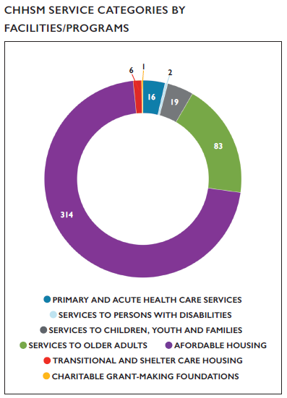
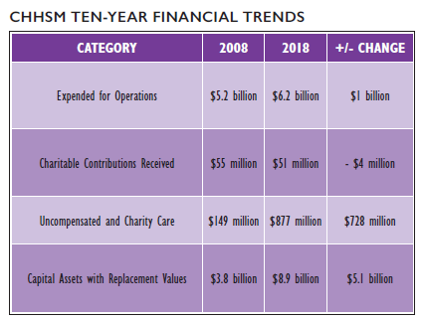
Special Report: Data Highlights on the UCC Council for Health and Human Service Ministries (CHHSM)
Notes:
The UCC’s Council for Health and Human Service Ministries (CHHSM) is an association of 71 corporate members, nearly 60,000 employees and more than 400 member ministries—each founded by a UCC congregation, member or minister—and recognized by one of the UCC’s 38 Conferences. Services provided by CHHSM organizations are categorized within one of seven general areas: Primary and Acute Health Care Services, Services to Persons with Disabilities, Services to Children, Youth and Families, Charitable Grant-Making Foundations, Transitional and Shelter Care Housing, Services to Older Adults, and Affordable Housing (currently the largest category). CHHSM member organizations provide data annually on the impact of their services, which are shared in the UCC Yearbook & Directory as well as a more detailed Annual Report available at www.chhsm.org.
In 2018, CHHSM ministries:
Served 5,179,619 individuals including: 10,640 children; 9,414 youth; 8,383 families; 24,940 older adults; 3,911 veterans; and provided community-based ambulatory health care to over 5 million people
Operated 36,980 residential units including: 19,682 affordable housing units; 9,158 independent living units; and 3,237 assisted living units
Operated facilities with 12,600 beds providing acute, skilled nursing, and memory care
Cared for 67,800 children in residential and non-residential programs
Provided residential and non-residential services to over 1,200 people with developmental disabilities
Provided 347,891 hours of volunteer service
Provided $877 million for uncompensated and charity care
Received $51 million in charitable contributions
Expended $6.2 billion for operations with revenues of $6.7 billion
Maintained capital assets with a replacement value of $8.9 billion
Employed 59,987 people
FINANCIAL TRENDS
Keeping in trend with previous decadal data reported in the 2016 Statistical Profile, over the last decade, operating expenses for CHHSM organizations increased while receipt of charitable contributions decreased. Uncompensated/charity care totals increased significantly by $728 million from 2008 to 2018.

Slide 38
Special Report: Insurance Board’s Findings - Church Vulnerability
46% received property valuations that were more than the amount listed on their policies. 29% had property values 15% greater than insured amount, and 22% had property values 25% greater than insured amount. Variances in values are common but can be a concern when they are significantly (greater than 10% of total insured value) out of line and churches may find that their policies will not cover the replacement of their buildings if they face a total loss.
51% did not have a formal written policy for financial controls. A formal system of financial controls is needed to include “separation of duties” principles which should address handling of cash collections, purchasing, electronic fund transfers, credit card use, and banking procedures. The procedures will assure the integrity of church assets and protect individuals who conduct financial transactions.
28% of the churches surveyed had yet to establish a formal child abuse prevention program. Written policies and procedures for child abuse prevention are needed which include elements of screening and selection, adult-child interaction guidelines, monitoring procedures, security, training and reporting of suspected abuse as required by state law. The objective of a comprehensive program is prevention of abuse of children or other vulnerable adults.
34% did not require a lease or use agreement for third par-ties utilizing church facilities. Whether or not rent is paid, churches need to utilize formal lease or use agreements with all non-church user groups. Written agreements define responsibilities to maintain and secure premises and to provide appropriate insurance coverage. Lease/use agreements should contain an indemnity agreement by which the tenant/user agrees to hold harmless, defend and indemnify the church for claims arising out of the user’s use of the facilities to include injury to user’s employees. For permanent tenants/users, agreements define responsibilities to provide liability, property and workers’ compensation insurance.
20% did not obtain background checks for employees and/or volunteers. The first component of an abuse prevention pro-gram is the proper screening of volunteers/employees. Basic due diligence requires that all staff and volunteers who work with children receive a background check and best practice is to run a check on all individuals that will work with the church.
16% did not provide abuse training. The second component of an abuse prevention plan is the documented training program by which staff/volunteers learn about predatory behavior and how to recognize that a child is in distress. Abuse prevention training should be provided to all staff/volunteers that work with children.
Notes:
Insurance Board partners with the ACS Group to offer a survey and inspection service geared to churches and their missions. The surveys include an onsite visit, consultation and follow-up. Activities include evaluating the church’s current loss control procedures and activities, evaluating building protection, identifying and analyzing potential loss exposures, evaluating preventive and corrective maintenance procedures, and performing a property valuation. Since the start of 2018, ACS has completed 92 surveys on Insurance Board UCC churches. The following presents a summary of the findings.
KEY TAKEAWAYS
While most church leaders have a good idea of the value of their building and its contents, you can never be completely sure that the church’s assets (both building and contents) are insured for full value. If possible, and if you have the resources available, it is best to update the valuation of your church once you have been in the program for an extended period.
Whether or not rent is paid, church leaders need to utilize formal lease or use agreements with all non-church user groups. Written agreements define responsibilities to maintain and secure premises and to provide appropriate insurance coverage.
Your church’s policies and procedures are not something you draft as a compulsory item for running a small business. Well drafted abuse prevention policies protect those most at risk in your congregation from abuse and bullying. Well drafted financial controls help ensure that the church will receive the benefit of the donations and funds generated.

Slide 39
Special Report: The Church Building
BUILDING OWNERSHIP
Based on a survey of congregations of the United Church of Christ, most (92.9%) report that they own their building/place of worship (with or without mortgage). And of those who own real estate, churches own between, on average, one to two buildings (1.60).
BUILDING AGE
Surveyed congregations report an average building age of 97 years, with buildings ranging from newly-constructed buildings that are less than a year old to places of worship older than 340 years. Subsequently, United Church of Christ congregations report that, since their founding, they have occupied, on average, two to three (2.42) different places of worship.
BUILDING RENOVATIONS & PROJECTS
The United Church of Christ Cornerstone Fund was founded in 1993 to assist churches and affiliated ministries with financing for construction and renovation projects. In 2019, the Cornerstone Fund, with the help of its investors, is supporting more than 225 congregations and ministries with financing for projects that help ministries save $3.1 million per year in interest charges with loan refinancing; complete building improvement projects that have reduced energy usage by more than 350,000 kWh per year; make accessibility improvements that serve more than 12,000 people; build more than 350,000 square feet of space; expand local daycares and early childhood development centers; develop and built affordable housing; enlarge their food pantries and homeless shelters; and, renovate their community rooms/ centers and places of worship.
Notes:
SURVEY CONDUCTED IN MAY 2019 WITH UNITED CHURCH OF CHRIST CONGREGATIONS WITH A +/- 5% CONFIDENCE INTERVAL (N=356)

Slide 40
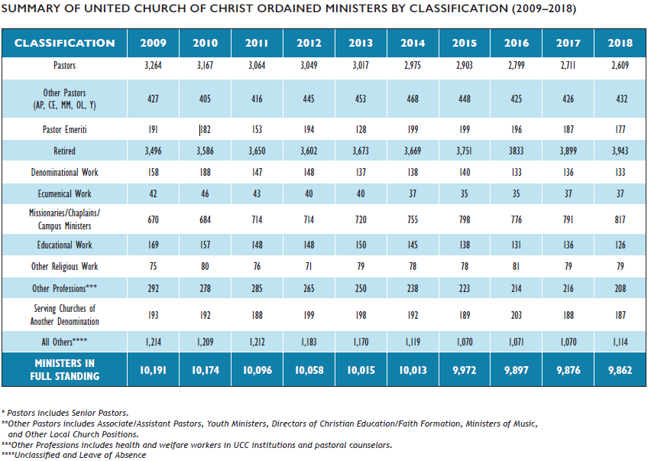
Appendix

