Slide 3
Congregations and Members
Notes:
At the end of 2017, there were 4,956 congregations in the United Church of Christ with a total of 853,778 members. Overall, the membership of the UCC represented less than one percent (0.6%) of total U.S. congregational membership and was concentrated in the Great Lakes, Middle Atlantic, and New England regions of the country.
In determining congregational statistics by state, 11.8% of all UCC congregations were located in Pennsylvania, which reported the greatest number of congregations. In total, the top five states with the most congregations contained over one-third (37.7%) of all UCC congregations.

Slide 4
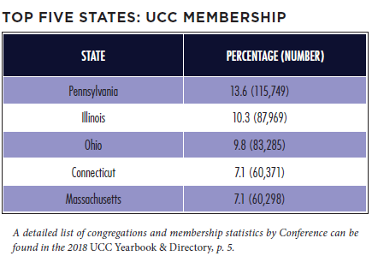
Congregations and Members
Notes:
Membership was concentrated largely in Midwestern / Northern and New England states with 47.7% of all UCC members in five states alone. Not all states with the greatest number of churches possessed the greatest number of members, however. For example, only 4.6% of all UCC congregations were located in Connecticut; but more members were reported in this state (60,371) than in New York (30,141) even though New York reported more congregations. This indicates that average church membership was greater in Connecticut than in New York.

Slide 5
Growth and Decline
Notes:
Similar to other Protestant denominations, the UCC has experienced a decline in the numbers of congregations and members in recent decades. From 2006 to 2016 alone, the UCC encountered a net loss of 518 congregations and 316,091 members. Some of this decline, however, began prior to the formation of the denomination in 1957 as the number of congregations steadily decreased despite membership increases in the UCC’s early years.
In 2017, 74 congregations were removed from denominational records. Despite this decrease, congregational decline has slowed in recent years. From 2005 through 2007, the UCC experienced a loss of nearly three congregations per week on average (mostly as a result of General Synod’s resolution regarding same-sex marriage). In the past year, however, only one congregation was eliminated from denominational records every 1 1/4 weeks.
Inversely, 25 congregations were added to denominational records in 2017. In total, 85 congregations received standing and were added to the UCC over the last five years. In this same time period, a new congregation (a church that received standing, affiliated, or merged with another congregation) was added about every three weeks.

Slide 6
Membership Growth and Decline
Notes:
In general, the number of members removed each year exceeds the number of members added for that same time period. Members are removed from denominational records for a number of reasons including death, transfer of membership to another denomination, or updating of local church membership records.
The difference between UCC members added and removed was smaller in 2017 than in 2015. In 2017, 20,960 members were added and 37,620 members were removed, with a net loss of 16,660 members. In 2015, there was a net loss of 19,625 members. (Note that net loss figures represented here are different than figures represented in the UCC Yearbook & Directory, which are based on total membership.) Over time, addition and removal differences have fluctuated; but both have decreased steadily as total membership has decreased.

Slide 7
Congregations by Race/Ethnicity
Notes:
A significant majority of congregations in the UCC self-identify as White/ Euro-American (meaning that most members of a congregation belong to that particular racial/ethnic group). Over time, however, the UCC as a whole is becoming more racially/ethnically diverse. Over the last decade, the percentage of primarily White/Euro-American congregations decreased from 90.4% in 2007 to 83.1% in 2017; and the percentage of Bi-Racial/Multi-Racial and Other congregations increased from 1.5% in 2007 to 7.5% in 2017. In addition, the percentage of Asian/Pacific Islander congregations increased to 3.8% in 2017 from 3.1% in 2007. One cause of this shift over time may be due to the fact that the majority of congregations that close, merge, or disaffiliate with the denomination are primarily White/Euro-American congregations, thus decreasing their overall percentage. This is also coupled with the fact that newer UCC congregations tend to be more racially/ethnically diverse.

Slide 8
Congregations by Date of Organization
Notes:
While the UCC has only been in existence since 1957, many of its congregations were founded by predecessor denominations. Over two thirds of churches (68.8%) were organized before 1900. Two out of ten congregations (21.0%) were organized between 1900 and 1969, and one in ten (10.3%) were organized in the last 47 years. Over time, the percentage of the UCC’s newer churches is slowly increasing while the percentage of older churches is slowly decreasing.

Slide 9
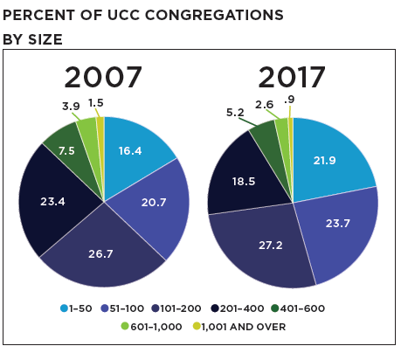
Congregation Size by Membership
Notes:
Nearly three in ten UCC members (29.4%) belong to congregations of 201-400 members, and this figure did not change significantly over the past decade. An increased percentage of UCC individuals held membership in smaller churches over this same time period, however, with 36.4% of all members attending congregations with 200 or fewer members in 2017 compared to 27.7% of all members in 2007. This trend is expected to continue in future years.
As a result, percentages of smaller membership UCC congregations increased over the past decade. Four in ten congregations (45.6%) reported a membership of 100 or fewer, compared with 37.1% in 2007. Congregations with 101-200 members increased slightly since 2007, from 26.7% to 27.2%.

Slide 10
Worship Attendance
Notes:
When considering worship attendance figures rather than membership size, even more congregations are categorized as smaller churches. In 2017, eight in ten churches in the UCC (83.4%) had a weekly worship attendance of 1–100, a 10.5% increase from 2010 and a 35.8% increase from 2000. Over time, the percentage of congregations with greater worship attendance numbers has decreased steadily, with the most dramatic decreases occurring in congregations of 101-400 worship attenders since 1995. As a result, half (50.9%) of all UCC congregations now have a weekly worship attendance of 1–50 individuals.

Slide 11
Worship Attendance and Membership
Notes:
The relationship between worship attendance and membership is shifting incrementally over time. From 1995 to 2017, decreased percentages of people attended worship when compared to total congregational membership, except for the smallest membership congregations. On average, 73.4% of a 1-50 member congregation’s total membership attended worship on a weekly basis in 1995. In 2017, an average of 87.4% of members attended weekly worship for the same size congregation. Overall, a greater percentage of members regularly attend worship in smaller congregations when compared with larger congregations, which suggests that the nature of relationships in smaller versus larger congregations may affect overall participation rates.

Slide 12
Christian Education/Faith Formation
Notes:
Since the 1950s, enrollment and attendance numbers for Christian Education/Faith Formation programming (also known as Church School or Sunday School enrollment in previous years) has been declining along with membership numbers. While this decline is not surprising, it is interesting to note that overall participation/enrollment rates, when computed as a percentage of total membership, have decreased significantly from the 1950s and 1960s but has not changed dramatically in the last several years. Currently, percentages indicate that roughly two out of every ten people in the UCC (19.9%) participated in these types of programs in 2017, at least in the traditional sense.

Slide 13
Christian Education/Faith Formation
Notes:
When comparing participation/enrollment with average weekly attendance figures, even fewer children and adults participated in Christian Education/Faith Formation programs on a regular basis. The gap between enrollment and attendance has increased incrementally over time, meaning that smaller percentages of total participants in Christian Education/Faith Formation programs are attending these programs on a weekly basis. These patterns matched average weekly worship attendance patterns, which have also decreased over time.
In general, adult Faith Formation programs were attended more regularly than children/youth programs. This may be due to a number of factors including competing interests for young people’s attention on Sunday mornings, the overall decline in numbers of younger people in congregational life, and increases in the diversity of family situations around divorce and co-parenting.

Slide 14
Congregational Designations
Notes:
In the past decade, there was a 102.9% increase in the number of Open and Affirming (ONA) congregations in the United Church of Christ, from 720 churches (13.4% of all UCC churches in 2007) to 1,461 churches (29.5% of all UCC congregations in 2017). The majority of congregations that were identified as ONA tended to be organized prior to 1940 since the majority of all UCC congregations were organized in this time period as well; however, it is important to note that greater percentages of newer congregations were identified as ONA compared with older congregations. For example, nearly four in ten (39.5%) congregations that organized since 1970 were identified as ONA. Older congregations organized prior to 1970 were less likely to be ONA (28.4%).
Roughly eight in ten (85.5%) congregations self-identified as being accessible to individuals with disabilities. While the specific types and degrees of accessibility among these congregations were not known, it is interesting to note that congregations organized before 1970 identified as accessible at greater percentages (86.0%) than congregations organized since 1970 (71.5%).

Slide 15
Congregational Outreach
Notes:
Reporting statistics indicated that an average of 2,162 community members were impacted by each local church’s outreach activities and initiatives in 2017. This was an increase of 137.8% from 2016. As expected, larger congregations reported greater numbers. The total sum of community members engaged in 2017 was 3,903,843 with 34.9% of all congregations reporting (including new/proposed congregations), which was a 409.1% increase from 2014 (766,719 engaged with 22.4% of congregations reporting), the first year that this category was included in annual church reporting. The significant increase was due most likely to increased familiarity with, and awareness of, this reporting category by local churches.

Slide 16
Mission/Immersion/Service Trips
Notes:
Since 2014, congregations have been asked to report whether members of their congregation participated in a U.S. or international mission/immersion/service trip. In 2017, 618 (12.3%) congregations reported that members had participated in these types of trips (including new/proposed congregations). This was an increase from 2014 when 416 (8.1%) congregations reported trip participation.

Slide 17
Summary of UCC Ordained Ministers
Notes:
At the end of 2017, there were 9,876 reported Ordained Ministers in Full Standing, including Retired Ministers and Pastor Emeriti. Of those 9,876 Ordained Ministers, nearly one-half (47.8% or 4,720) were employed, with 70.4% (3,325) of those employed actively serving in a local church (either a UCC church or non-UCC church). Four out of ten (41.4% or 4,086) were Retired Ministers or Pastor Emeriti, and 10.8% (1,070) were unclassified (ministers who did not hold a position at the time of Yearbook production or whose position had not been reported at that time) or were on a leave of absence.
Over the last 32 years (1985 to 2017), Ordained Ministers only had a numerical net decrease of 209 (2.1%). However, the number of employed Ordained Ministers decreased by one third (-33.8%), while Retired Ministers and Pastor Emeriti saw an increase of 82.4% over this same 32 year period.

Slide 18
Authorized Ministers
Notes:
As of December 31, 2017, there were a total of 6,948 active (non-retired) Authorized Ministers in the United Church of Christ (Ordained, Licensed, Dual Standing, Ordained Ministerial Partner, and Standing Commissioned). Ordained Ministers were the largest percentage of active ministers reported (83.3%); and Licensed Ministers comprised the second largest group of Authorized Ministers (8.9%). In addition, four ministers hold standing in the Congregational Christian Church.

Slide 19
Trends in Ordained Ministry
Notes:
Since 1990, the number of Ordained Ministers has remained relatively stable, though there are slight incremental decreases in more recent years. In addition, the number of Retired Ministers and Pastor Emeriti has increased steadily. Interestingly, in this same time period, the number of Ordained Ministers serving in local congregations decreased at steadily similar rates due to overall congregational and membership decline. If past trends continue, which are predicted to be the case, there will be no clergy supply shortage in future years, even though retirements continue to increase.

Slide 20
Authorized Ministers by Age
Notes:
Statistical information regarding Authorized Ministers in the denomination reflects an increasingly aging population. When all active (non-retired) Authorized Ministers were considered, over one half were age 60 and above (54.1%) and over one-fourth were 50-59 (25.5%), making 79.6% of all active ministers age 50 and over. When measuring changes over time, the percentage of local church pastors and co-pastors under 60 decreased in the last thirteen years from 67.6% in 2004 to 48.2% in 2017, while pastors and co-pastors 60 and over increased significantly (from 28.4% in 2004 to 51.8% in 2017).

Slide 21
Authorized Ministers by Race/Ethnicity
Notes:
The majority (87.3%) of all active, non-retired UCC Authorized Ministers identified as White/Euro-American, with 12.7% identifying as non-white.
Among the various types of authorization, Ministers with Dual Standing were the most racially/ethnically diverse group with three in ten (29.5%) ministers
listed as non-white. Commissioned Ministers and Ministers with Ordained Ministerial Partner Standing were the least racially/ethnically diverse
authorization groups, with no Asian/Pacific Islander, Native American, or Bi-Racial/Multi-Racial ministers listed within denominational records.

Slide 22
Ordained Ministers in Local Churches by Race/Ethnicity
Notes:
Regarding racial/ethnic representation in local church pastor positions, active, non-retired White/Euro-American Ordained Ministers were over-represented in all positions except for the role of associate/assistant pastor. For example, while only 88.3% of all UCC Ordained Ministers identified as White/Euro-American, they constituted 90.4% of all senior/solo pastors. Interestingly, there is significant over-representation in associate/assistant pastor roles by African-Americans (17.5% representation compared with 7.8% overall representation) and Hispanics/Latinos (2.5% representation compared with 1.1% overall representation).

Slide 23
Authorized Ministers by Gender
Notes:
In total, approximately 50.0% of active, non-retired Authorized Ministers in the United Church of Christ identified as female, 49.8% identified as male, and 0.2% identified as transgender/gender-variant. The percentage of active, non-retired female Ordained Ministers (51.0%) continues to exceed the percentage of active, non-retired male Ordained Ministers (48.8%). According to the 2003 UCC Statistical Handbook only 27% of all Ordained Ministers were female. In general, there were more Licensed and Dual Standing ministers who identified as male; but there were nearly four times as many female Commissioned Ministers when compared to males.

Slide 24
Ordained Ministers in Local Churches by Gender
Notes:
The percentage of active, non-retired female Ordained Ministers serving in local church pastoral positions has increased significantly over time, from 31.9% in 2005 to 45.8% in 2017. Four in ten (40.6%) senior/solo pastors identified as female in 2017, compared with 30.2% in 2005. Over half (57.8%) of co-pastors, half (51.1%) of interim/designated-term/supply pastors, and over two-thirds (70.5%) of associate/assistant pastors identified as female.

Slide 25
Ordinations and Members in Discernment
Notes:
The number of ordinations per year decreased over the past decade from 191 in 2008 to 127* in 2017. Throughout this time period, the 2012–2016 annual average of ordinations was 158 compared to the 2007–2011 annual average of 183 ordinations. When reviewing trends over the past several decades, however, ordination numbers fluctuated in similar ways; and it is yet to be seen whether this recent decrease signals a continuing trend.
As of March 2018, there were 741 active Members in Discernment on record within the denominational database. Members in Discernment (or MIDs) were concentrated within larger Conferences, as is to be expected, with the Massachusetts, Illinois, Connecticut, and Ohio Conferences reporting 28.3% of the total number of MIDs.
In terms of gender, females comprised 54.7% of all MIDs (a greater percentage than that of current female Authorized Ministers). Members in Discernment were also more racially/ethnically diverse than current Authorized Ministers with 23.1% identifying as non-white (compared with 12.7% of all Authorized Ministers identifying as non-white).

Slide 26
Local Church Financial Trends
Notes:
Operating expenses for an average local congregation in 2017 was $176,546, a $8,013 (+4.8 %) average increase from 2016. Average total income for a local church in 2017 was $249,919, a $23,953 (+10.6%) average increase from 2016. Both the average expenses and income for local congregations increased from average amounts reported over the past decade—from $152,194 in expenses (a 16.0% increase) and $209,863 in income (an 19.1% increase) in 2007.
In 2007, Our Church’s Wider Mission (OCWM) giving represented 5.0% of total local church expenditures. This percentage decreased to 3.5% of total local church expenditures in 2017.
Overall, expenditures for congregations of the United Church of Christ increased from $923,757,089 to $963,940,389 in a period of four years (December 31, 2013 to December 31, 2017)—a 4.3% increase. This figure fluctuates annually, with some years experiencing increases in overall expenditures.

Slide 27
Stewardship and Mission Support
Notes:
Totals for wider church stewardship and giving by local congregations of the United Church of Christ decreased over the past several years. Over the past decade, the number of churches that have not given to any Special Mission Offering has increased.
In previous years, local church participation rates in each of the Special Offerings have been on the increase over the previous decade. However, in 2017 this trend began to reverse. Strengthen the Church is the only offering that saw an increase in local church participation in the previous decade (from 30.6% in 2007 to 42.2% in 2017). Strengthen the Church is also the only offering that has increased in total giving in the previous decade (+31.3%). One Great Hour of Sharing and Neighbors in Need have decreased in total giving by 24.4% and 20.8%, respectively. Giving to Christmas Fund has only decreased slightly (-3.7%).

Slide 28
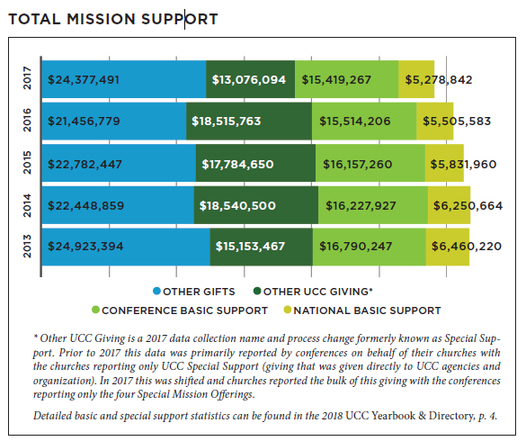
Stewardship and Mission Support
Notes:
Total mission support for 2017 decreased from the previous year by $2,840,637 (-4.7%). However, Other Gifts—money given beyond the UCC—has increased by $2,920,712 (+13.6%). Total Basic Support, that is Conference Basic Support plus National Basic Support, has experienced a slight decrease from the previous year ($321,680 or -1.5%). While the data indicates that Other UCC Giving has decreased dramatically (-29.4%) it is important to note that in 2017 the manner in which this data was collected changed.*

Slide 29
The Church Dollar
Notes:
In the last two decades, the distribution of the church dollar has experienced some noticeable shifts. Current local expenses have increased by $.07 while all others have decreased or remained steady. All types of UCC Giving (Conference Basic, National Basic and Other UCC Giving) have decreased.

Slide 30
Special Report: Statistical Highlights on Advocacy Through the Justice and Peace Action Network
Notes:
Supported by timely updates and online action opportunities through our Justice and Peace Action Network (JPANet), the United Church of Christ advocates engaged in advocacy with their elected officials using our digital advocacy tools more than 76,837 times in 2017. Our collective rate of engagement continues to grow. In the first six months of 2018 members of the JPANet generated 40,973 messages to decision makers.
This rise in denominational digital advocacy is unprecedented. The 2017 action rate is a remarkable increase over the recent past, and represents more than twice the number of actions we collectively generated in all of 2016 (28,599 contacts).
Along with our action rate, the UCC’s network of advocates continues to grow at a sustained rate. Since May 2016, we have seen a steady and consistent growth of our advocate base across time, an average that comes out to approximately 256 new advocates per month for the last 1.5 years.
What does this look like in practice? Our Twenty-seventh General Synod called for affordable, accessible and equitable health care for all people as a matter of faith. On health care alone, a major focus of our 2017 legislative advocacy work, 2,600 advocates generated 9,653 messages to Congress through emails, calls, Facebook posts and Tweets. This advocacy, combined with the prayers and efforts of many others, contributed to preventing dangerous attacks on our health care system that would have left millions without access to care and devastated the Medicaid program.
Similarly, following the declaration of the UCC as an immigrant welcoming denomination at the Thirty-first General Synod, UCC advocates have engaged in sustained advocacy in solidarity with immigrants and refugees. This has been especially important during a season in which we have seen sustained attacks on these communities. In the first half of 2018, 3,196 members of the JPANet generated 17,918 messages to legislators on a number of issues including:
● Support of young immigrants seeking a pathway to citizenship through the Dream Act;
● Opposition to devastating proposed changes to legal immigration;
● Calls to the practice of family separation and unite families;
● Support for increase refugee resettlement and more.
This advocacy, combined with prayers, public witness and a growing sanctuary movement within the United Church of Christ have served to prevent some of the most harmful policy attacks on immigrants, refugees and asylum seekers. They are also an important part of our ongoing commitment to welcome the stranger and live out our love of neighbor and of children.
TO LEARN MORE AND JOIN THE JUSTICE AND PEACE ACTION NETWORK, SIGN UP HERE: WWW.UCC.ORG/JOIN_THE_NETWORK

Slide 31
Special Report: Becoming a Green Denomination: UCC Climate Survey Results
Notes:
A climate survey of 843 respondents from the UCC revealed that our clergy and laity possess a strikingly “green” outlook in comparison to national averages. For instance, 97% of UCC respondents were personally concerned with climate change with 88% being very concerned. This compares with a general population in which 76% were concerned and 44% were very concerned. In other words, those surveyed were two times more likely to be very concerned about climate change than the general population of the United States. Other highlights from the survey include:
● 63% of UCC respondents attributed climate change to human activities, more than double the national average of 27%. Only 1% of UCC respondents attributed climate change to natural causes, while 35% attributed it to a combination of human and natural causes.
● UCC respondents strongly favored a broad range of climate solution proposals at rates significantly higher than national averages. Notably, 98% of UCC respondents favored charging corporate polluters a fee for the pollution they created, while 98% also supported passing laws for more efficient buildings and cars.
● At much higher rates than national averages, most UCC respondents believed action on climate is urgently needed. While 98% of UCC respondents believed collective action was needed with 94% strongly agreeing, 77% of the broader nation believed collective action was needed and with 58% strongly agreeing.
While the survey results indicate a remarkable level of awareness and commitment in the UCC, there are also indications of room for growth. For instance, 31% wish their church would do more to conserve energy. Moreover, only 48% say their church is talking to staff and members about climate change, while only 34% are talking to the public about climate change.
This room for growth indicates the importance of congregations seizing opportunities to participate in a host of programs that collectively move members from individual awareness to public dialogue and collective action. Churches can start a book group to read Jim Antal’s Climate Church, Climate World. They can strive to become a Creation Justice Church. Further ideas for engagement can be found through the UCC’s Creation Justice Webinar series as well as The Pollinator, the UCC’s environmental justice newsletter.
TO SIGN UP FOR THE POLLINATOR NEWSLETTER VISIT WWW.UCC.ORG/POLLINATOR_SIGN_UP.
TO LEARN MORE ABOUT BECOMING A CREATION JUSTICE CHURCH GO TO:
WWW.UCC.ORG/HOW_IT_WORKS_BECOMING_A_CREATION_ JUSTICE_CHURCH

Slide 32
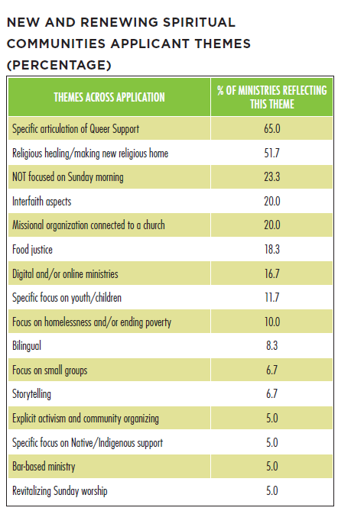
Special Report: New and Renewing Spiritual Communities Grant
Notes:
In the fall of 2017, the Congregational Assessment, Support, and Advancement team coded and categorized all the applications from churches and communities seeking funding to do something new in the evolution of spiritual communities (via the New and Renewing Spiritual Communities Grant.) From existing congregations seeking to evolve towards their mission to brand new communities gathering and engaging their spiritual understanding of the Gospel, the 78 applications reflected several key themes, as follows:
● 65% of the applications articulated an explicit commitment to being a welcoming place towards the LGBTQ community, regardless of the location (urban or suburban), or the racial ethnic makeup of the congregations.
● Over 50% of applications expressed a desire to make home again, and/or find a space of healing towards those who have been wounded by institutional Christianity in some form in the past. As one application wrote towards these two themes: “Our ongoing work is to uplift the most marginalized in our community and call for continued work towards justice and equality.”
In addition, we learned:
● 40% of applications were from self-identified communities of color, 13.3% reflecting multi-racial multicultural communities.
● 25% of applicants listed an endowment >$200,000 associated with their project. Of these applicants, half or 50% articulated actively investing in their own vision.
35% of the applications were from areas that are rural or suburban; 65% from urban settings.
The themes that arose are not reflective of every congregation doing something new in the United Church of Christ, and, the implication of what communities seeking support for their innovation have in common is a story that every congregation can learn from.
In the fall of 2018, new applications were added to the data set we have, and we can continue to recognize themes across communities and congregations seeking to do something new in the United Church of Christ.
FOR MORE INFORMATION ABOUT UCC’S NEW AND RENEWING SPIRITUAL COMMUNITIES GRANT, OR TO APPLY, PLEASE SEE WWW.UCC.ORG/GROW-YOUR-CHURCH.

